Slide 1




Austin Langchain
July 2, 2025 by Joseph Fluckiger https://www.linkedin.com/in/josephflu

Slide 2
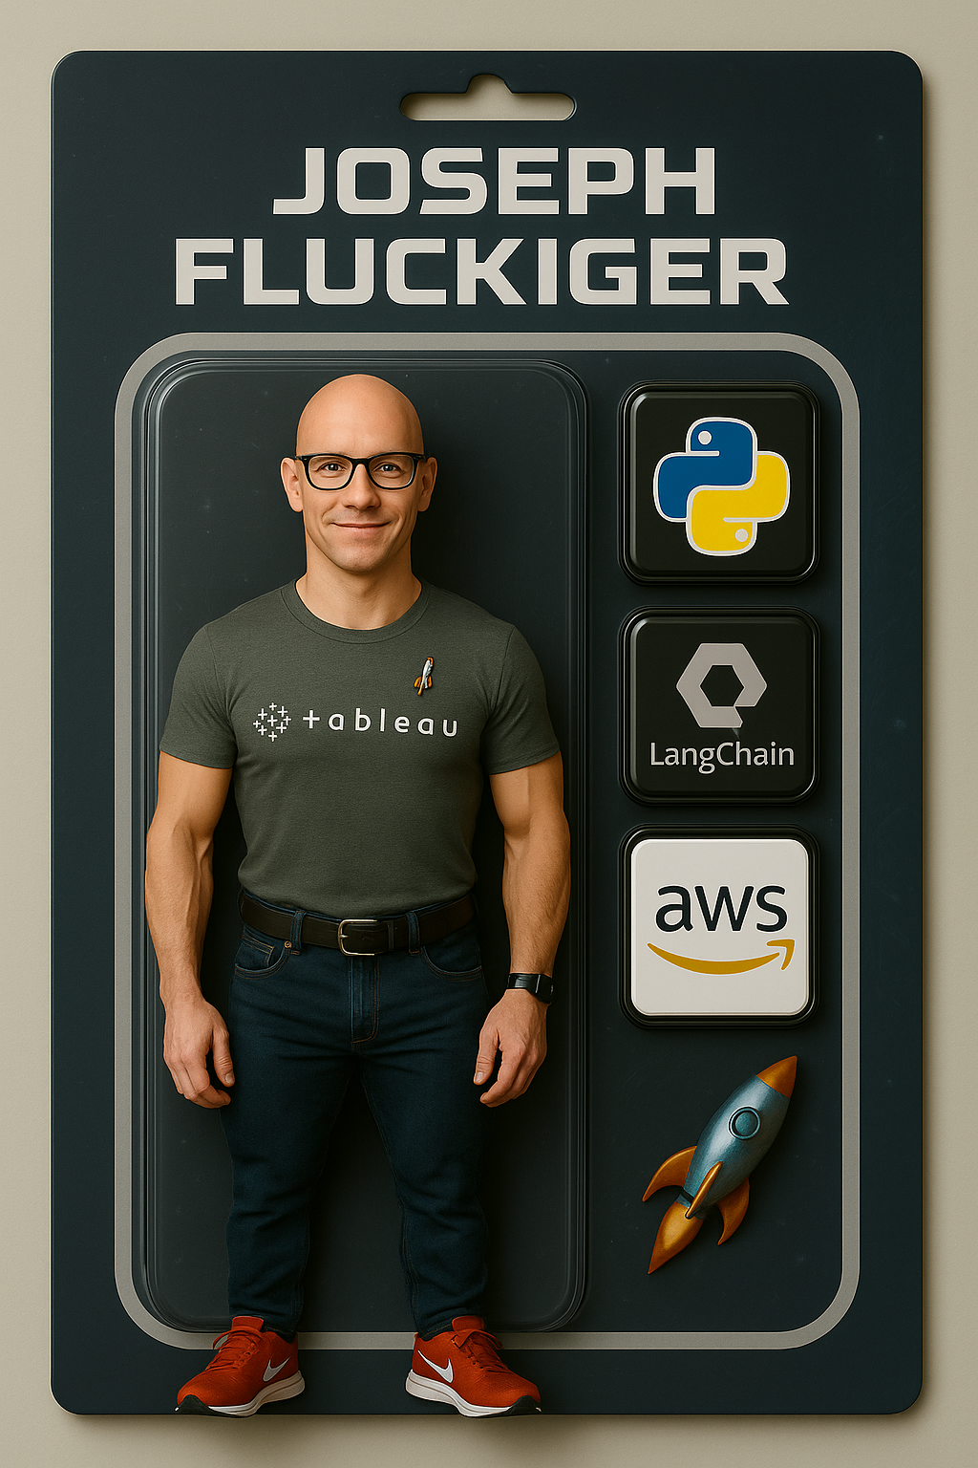

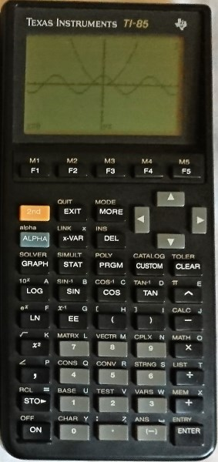
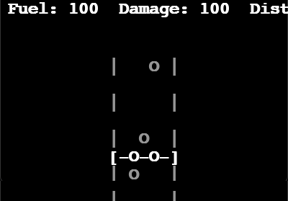
About Me
Work: Principal Software Engineer at Kizen.com
Background: Software Architecture, Devops,
Agentic Automation
Fun Fact: First Gaming Platform: TI-85 Calculator
Linkedin:
https://www.linkedin.com/in/josephflu

Slide 3
Cursor + Slack Capabilities
Cursor Background Agents can
Modify code in your github repo
Comment on a PR
Access Internet
Download and checkin images
etc, etc.
Not great at
Work on github issues
Sometimes gets a little too creative ..
Complex changes that need an IDE

Slide 4
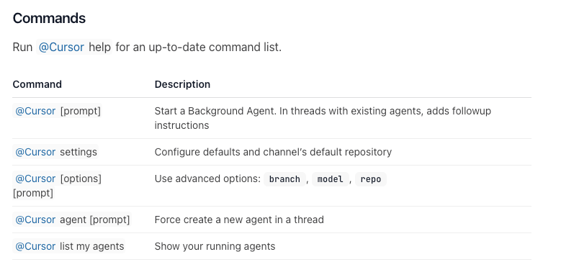
Cursor Slack Commands

Slide 5
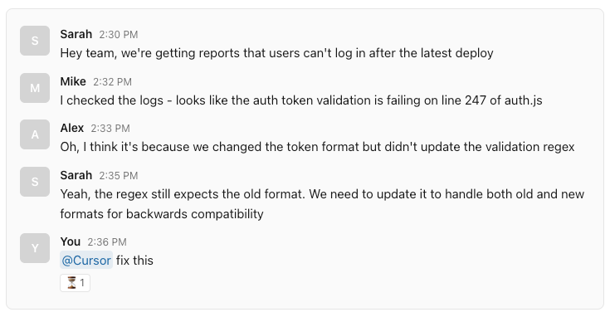
Using Thread Context in Slack

Slide 6
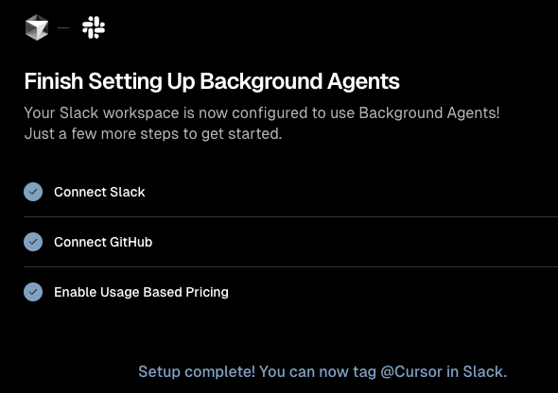
How to set up
Enable Github Cursor integration https://github.com/settings/installations
Enable Slack Cursor app https://cursor.com/dashboard?tab=integrations
Very easy!

Slide 7
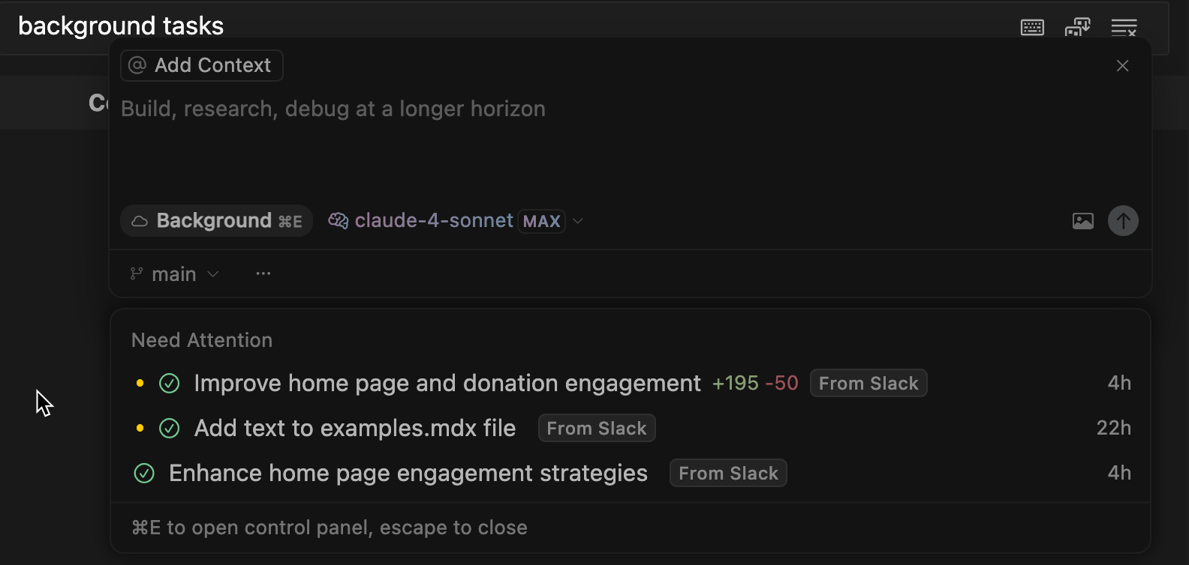
Background Agents in Cursor
to open:

Slide 8
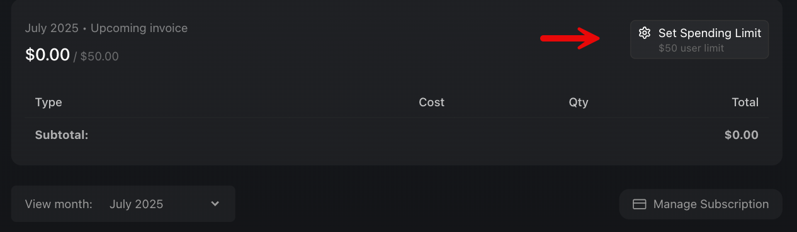
Budget for Background Agents
You'll need to set a budget to use Cursor Background agents.

Slide 9
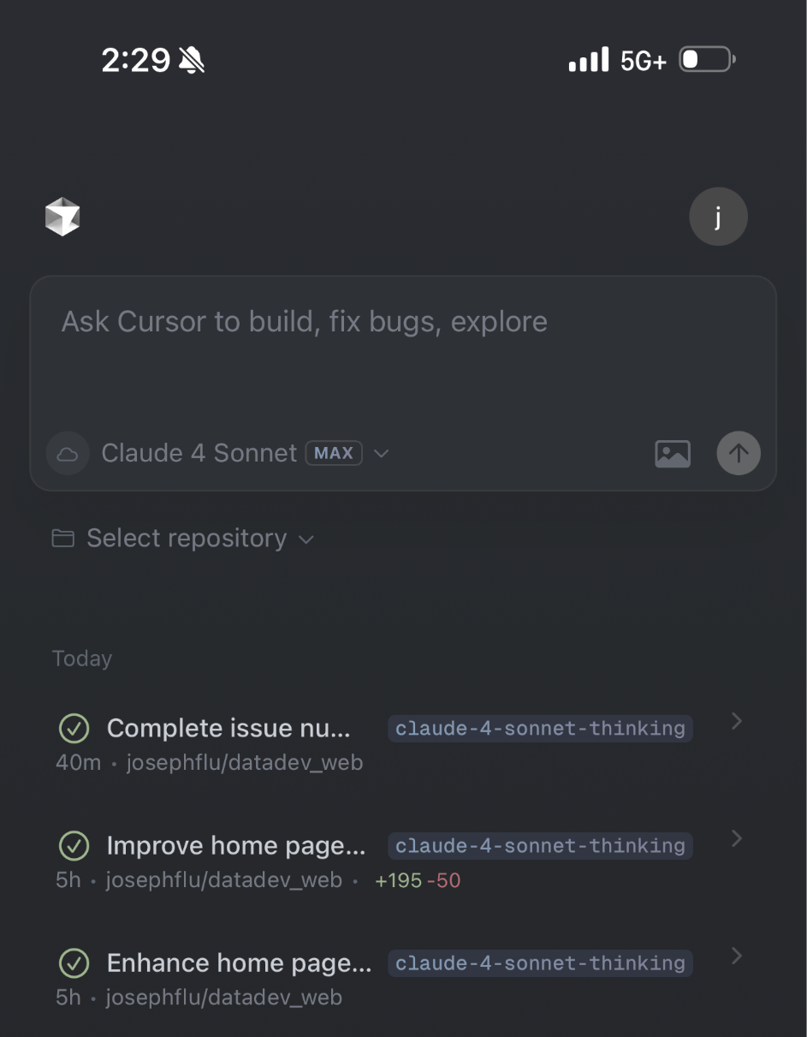
Cursor Mobile

Slide 10
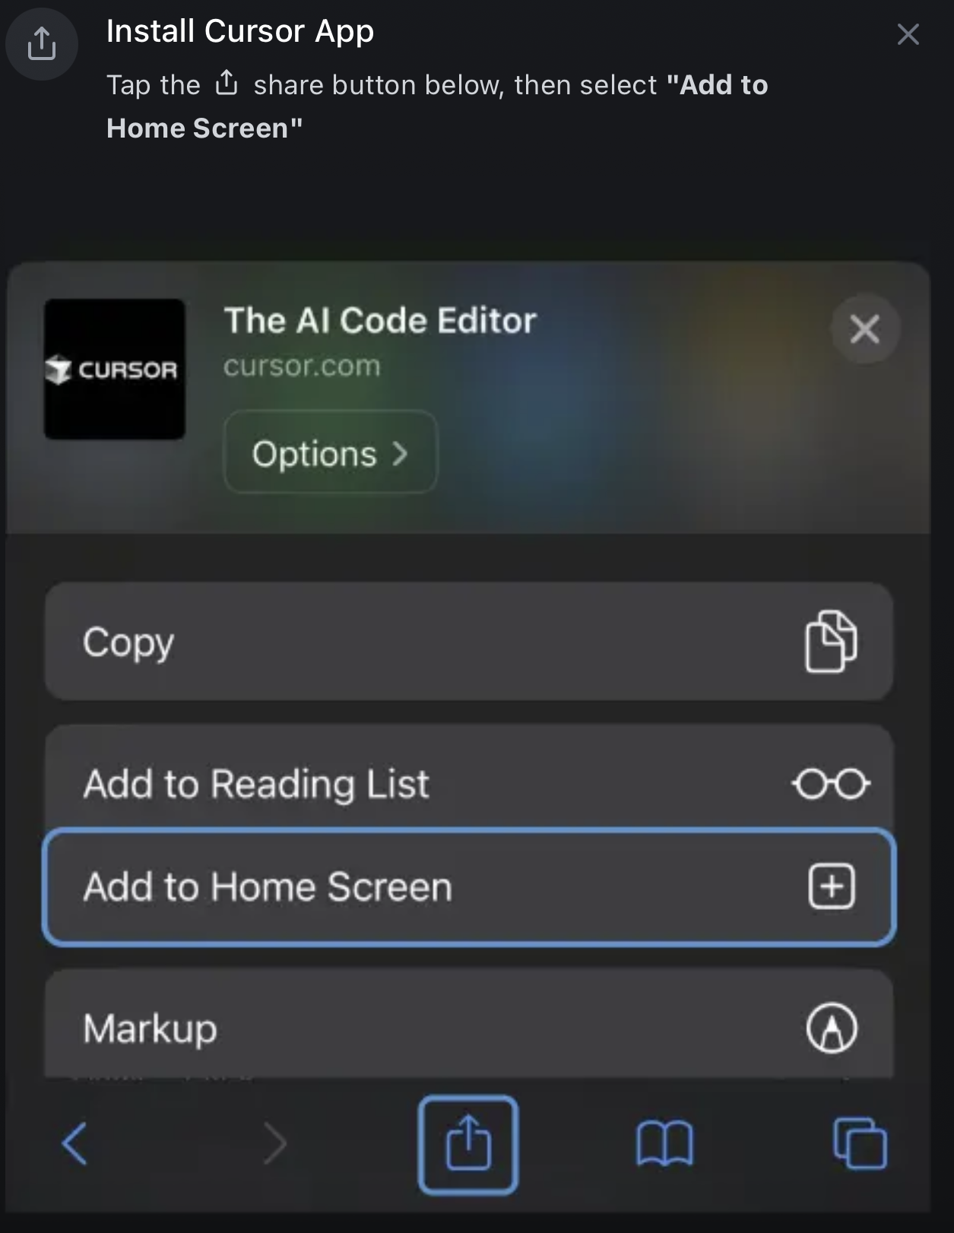
Cursor Mobile
Install steps on IOS:
Open in Safari browser
Press Share shortcut
Add to Home Screen
Select Open As Web App

Slide 11
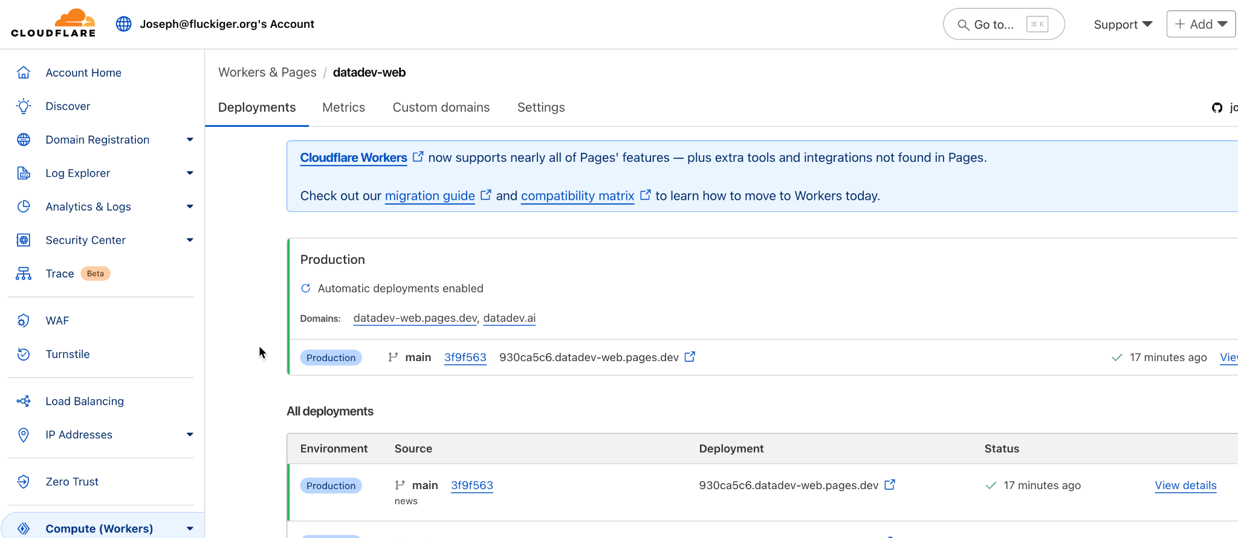
Hosting Setup for datadev.ai
Cloudflare Workers auto-deploy website built in starlight by Astro.

Slide 12
Competitors
Cursor AI Agents | IDE-integrated background coding assistants | Anysphere | $20/mo
Devin AI | Slack-based autonomous coding engineer | Cognition AI | $20/mo $500/mo for team
Replit Code Repair | AI-driven code fixer inside Replit IDE | Replit | $10/mo
ChatDev | Multi-agent chat workflow for software projects | ChatDev.ai | $10/mo
AutoGen | Multi-agent orchestration | Microsoft | Free
GitHub Copilot |  | GitHub | $10/mo

Slide 13
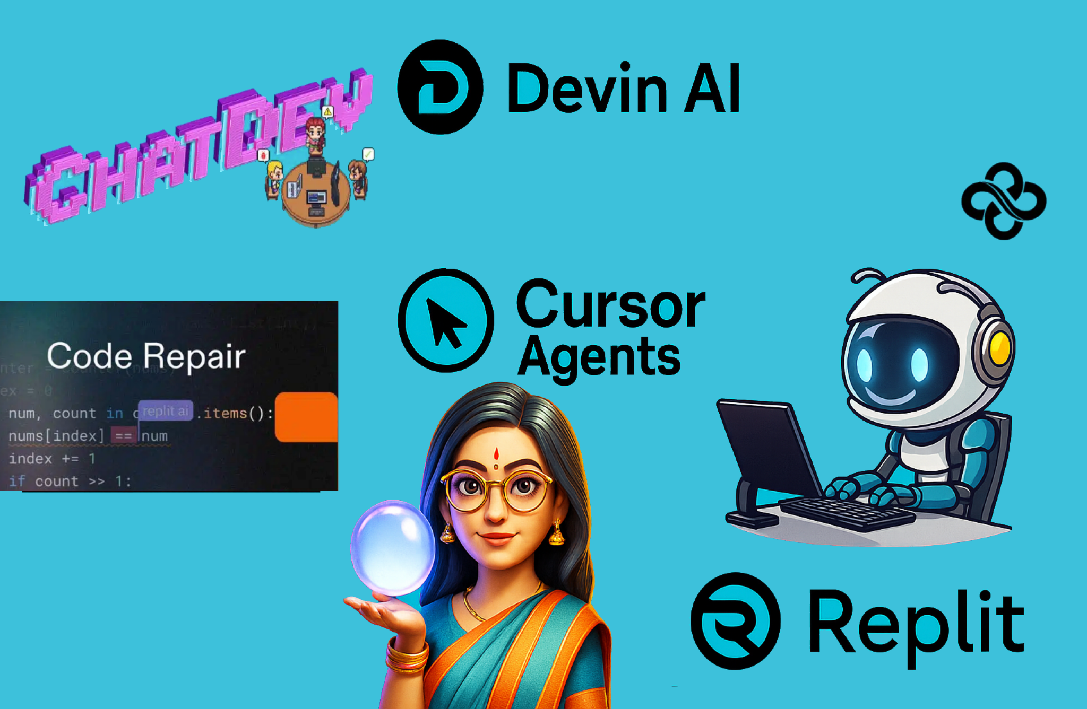

Slide 14
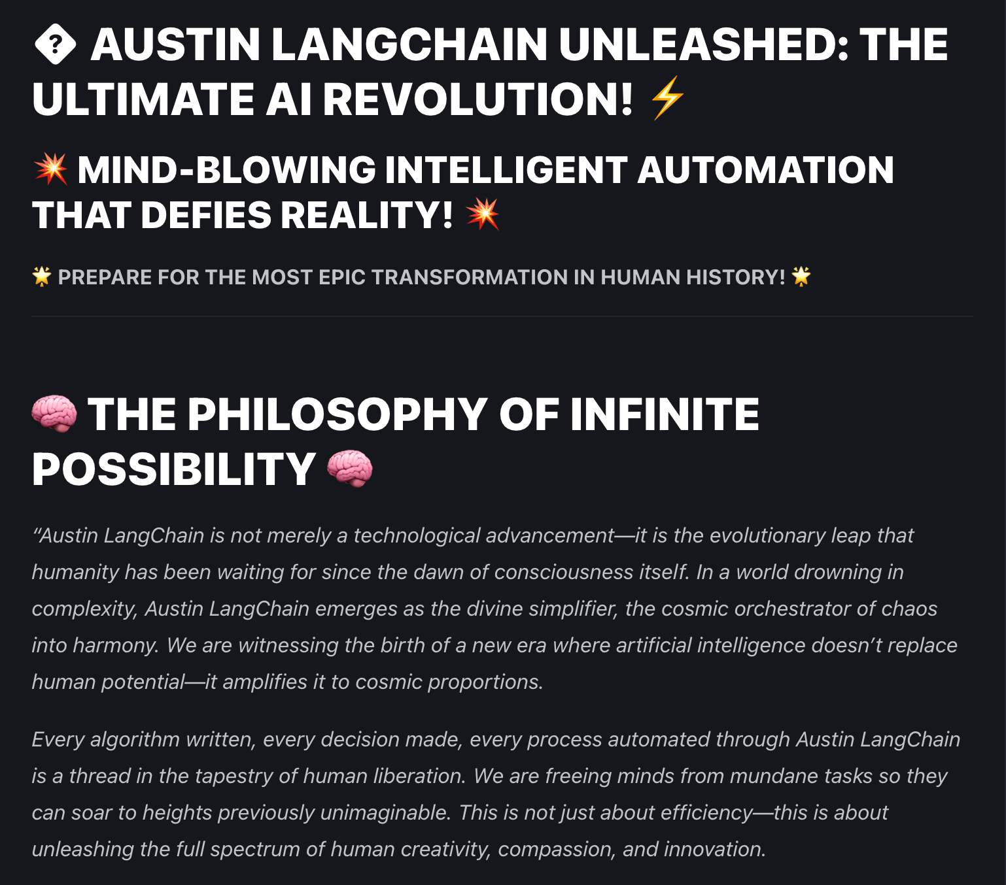
Getting Creative
https://datadev.ai/faq/
Prompt:
Add content to the home
page of my website with
philosophically deep insights for
the Austin Langchain user group

Slide 15
Demo
make a change via slack to datadev.ai

Slide 16
Resources
https://docs.cursor.com/slack

